Slide 1
WRES2203 Advanced Network Technology
Chapter 11
Monitoring the Network

Slide 2
Contents
Introduction
Syslog
SNMP
NetFlow

Slide 3
Introduction
Monitoring an operational network can provide a network administrator with information to proactively manage the network and to report network usage statistics to others.
Link activity, error rates, and link status are a few of the factors that help a network administrator determine the health and usage of a network.
Collecting and reviewing this information over time enables a network administrator to see and project growth, and may enable the administrator to detect and replace a failing part before it completely fails.

Slide 4
Syslog
Syslog was developed for UNIX systems in the 1980s.
Syslog uses UDP port 514 to send event notification messages across IP networks to event message collectors.
The syslog logging service provides three primary functions:
  The ability to gather logging information for monitoring and troubleshooting
  The ability to select the type of logging information that is captured
  The ability to specify the destinations of captured syslog messages

Slide 5
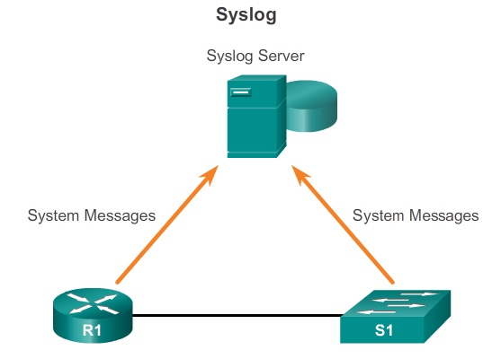
Syslog

Slide 6
Syslog
Syslog protocol send system messages and debug output to a local logging process internal to the device.
Network administrator may specify that only certain types of system messages are sent to various destinations.
For example, the device may be configured to forward all system messages to an external syslog server. However, debug-level messages are forwarded to the internal buffer and are only accessible by the administrator from the CLI.

Slide 7
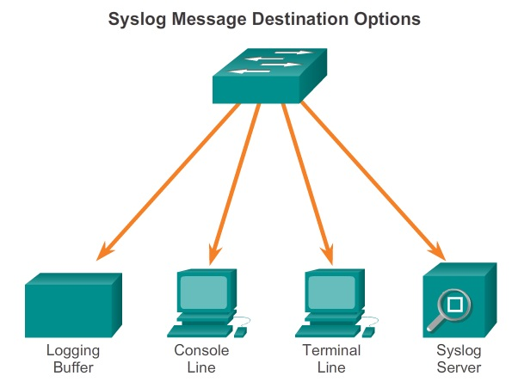
Syslog

Slide 8
Syslog
Every syslog message contains a severity level and a facility. The smaller numerical levels are the more critical syslog alarms.
Each syslog level has its own meaning:
  Warning Level - Emergency Level
    These messages are error messages about software or hardware malfunctions.
  Debugging Level
    Indicates that the messages are output generated from issuing various debug commands.
  Notification Level
    Information, device functionality is not affected.

Slide 9
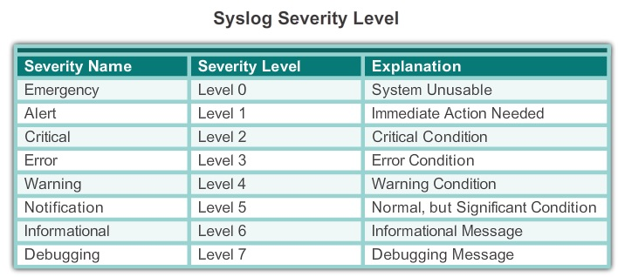
Syslog

Slide 10
Syslog
Syslog messages also contain information on the facility.
Syslog facilities are service identifiers that identify and categorize system state data for error and event message reporting.
Format of syslog messages
  seq no: timestamp: %facility-severity-MNEMONIC: description
  00:00:46: %LINK-3-UPDOWN: Interface Port-channel1, changed state to up
    Facility is LINK and the severity level is 3, with a MNEMONIC of UPDOWN.

Slide 11
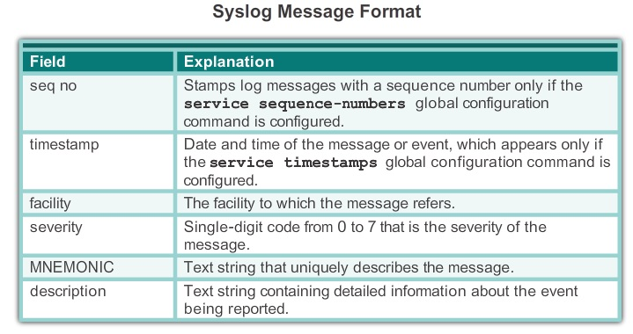
Syslog

Slide 12
Syslog
Log messages can be time-stamped and the source address of syslog messages can be set.
  service timestamps log uptime
  service timestamps log datetime
Setting the clock
  Manually set, using the clock set command
  Automatically set, using the Network Time Protocol (NTP)
    ntp master 1 (server)
    ntp server IPAddressOfNTPServer

Slide 13
Syslog
To view syslog messages, a syslog server must be installed on a workstation in the network. Example, Kiwi Syslog Daemon.
The server parses the output and places the messages into pre-defined columns for easy interpretation.
Network administrators can easily navigate the large amount of data compiled on a syslog server.
By default, Cisco routers and switches send log messages for all severity levels to the console.
  logging console and logging buffered
  show logging command displays the default logging service settings

Slide 14
Syslog
Configuring syslog
  Step 1. Configure the destination hostname or IP address of the syslog server.
    R1(config)# logging 192.168.1.3
  Step 2. Control the messages that will be sent to the syslog server with the logging trap level
  For example, to limit the messages to levels 4 and lower (0 to 4)
    R1(config)# logging trap 4
  Step 3. Configure the source interface
    R1(config)# logging source-interface g0/0

Slide 15
SNMP
Simple Network Management (SNMP)
  An application layer protocol.
  Allow administrators to manage nodes, such as servers, workstations, routers, switches, and security appliances, on an IP network.
  Enable network administrators to manage network performance, find and solve network problems, and plan for network growth.
  SNMP system consists of three elements:
    SNMP manager
    SNMP agents (managed node)
    Management Information Base (MIB)

Slide 16
SNMP
SNMP manager collect information from an SNMP agent using the “get” action and can change configurations on an agent using the “set” action.
SNMP agents can forward information directly to an NMS using “traps”.
SNMP agent and MIB reside on networking device clients. MIBs store data about the device operation.
SNMP defines how management information is exchanged between network management applications and management agents.
SNMP uses UDP, port number 162, to retrieve and send management information.

Slide 17
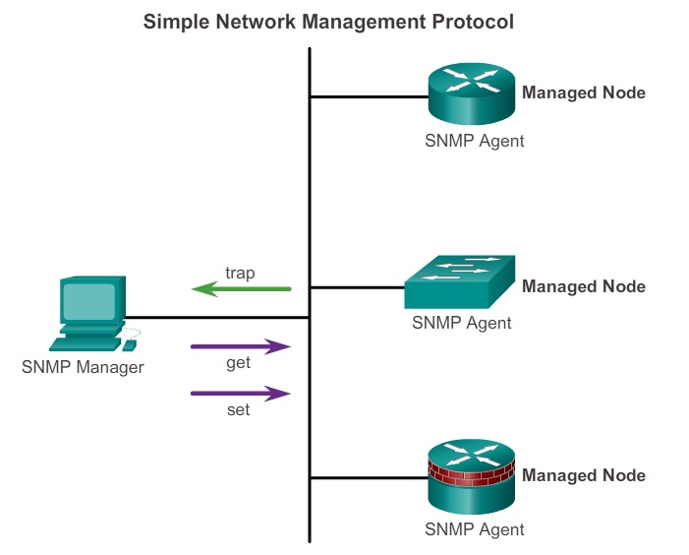
SNMP

Slide 18
SNMP
SNMP agent responds to SNMP manager requests:
  Get an MIB variable
    Response to a GetRequest-PDU from the NMS. The agent retrieves the value of the requested MIB variable and responds to the NMS with that value.
  Set an MIB variable
    Response to a SetRequest-PDU from the NMS. The SNMP agent changes the value of the MIB variable to the value specified by the NMS.

Slide 19
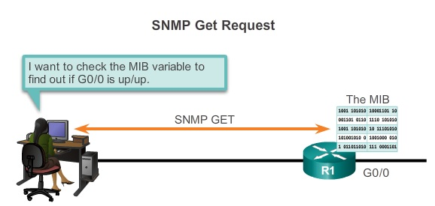
SNMP

Slide 20
SNMP
An NMS periodically polls the SNMP agents residing on managed devices.
Disadvantages
  There is a delay between the time that an event occurs and the time that it is noticed (via polling) by the NMS.
  There is a trade-off between polling frequency and bandwidth usage.

Slide 21
SNMP
To mitigate these disadvantages, it is possible for SNMP agents to generate and send traps to inform the NMS immediately of certain events.
Traps are unsolicited messages alerting the SNMP manager to a condition or event on the network.
Trap-directed notifications reduce network and agent resources, by eliminating the need for some of SNMP polling requests.

Slide 22
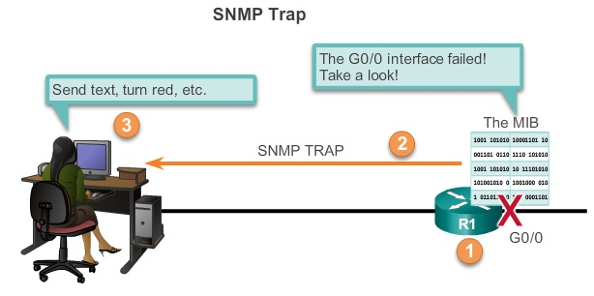
SNMP

Slide 23
SNMP
Several versions of SNMP
  SNMPv1
    Legacy
  SNMPv2c
    Utilizes community-string-based Administrative Framework.
    SNMP community strings authenticate access to MIB objects.
    Includes a bulk retrieval mechanism and more detailed error message reporting to management stations.

Slide 24
SNMP
  SNMPv3
    Interoperable standards-based protocol.
    provides secure access to devices by authenticating and encrypting packets over the network.
Types of community strings:
  Read-only (ro)
    Read access to all objects in the MIB.
  Read-write (rw)
    Read and write access to all objects in the MIB.

Slide 25
SNMP
MIB defines each variable as an Object ID (OID).
MIB organizes variables hierarchically in tree.
The MIB tree for any given device includes some branches with variables common to many networking devices and some branches with variables specific to that device or vendor.
The data is retrieved via the snmpget utility, issued on the NMS.
The snmpget utility requires that the SNMP version, the correct community, the IP address of the network device to query, and the OID number are set.

Slide 26
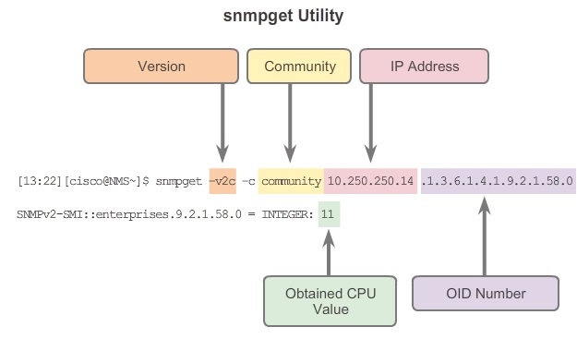
SNMP

Slide 27
SNMP
Configuring
  Step 1. Configure the community string and access level (read-only or read-write)
    snmp-server community string ro | rw
  Step 2. Document the location of the device
    snmp-server location text
  Step 3. Document the system contact
    snmp-server contact text
  Step 4. Restrict SNMP access to SNMP managers that are permitted by an ACL
    snmp-server community string access-list-number-or-name

Slide 28
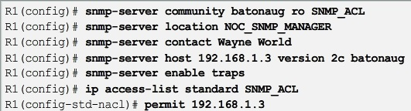
SNMP
  Step 5. Specify the recipient of the SNMP trap operations
    snmp-server host host-id [version{1| 2c | 3 [auth | noauth | priv]}] community-string
  Step 6. Enable traps on an SNMP agent
    snmp-server enable traps notification-types
  show snmp
  show snmp community

Slide 29
SNMP
Ensure that SNMP messages do not spread beyond the management consoles. ACLs should be used to prevent SNMP messages from going beyond the required devices.
SNMPv3 is recommended because it provides security authentication and encryption.
  snmp-server group groupname {v1 | v2c | v3 {auth | noauth | priv}}
  snmp-server user username groupname v3 [encrypted] [auth {md5 | sha} auth-password] [priv {des | 3des | aes {128 | 192 | 256}} priv-password]

Slide 30
NetFlow
NetFlow is a Cisco IOS technology that provides statistics on packets flowing through a Cisco router or multilayer switch.
NetFlow is focused on providing statistics on IP packets flowing through network devices.
NetFlow provides data to enable network and security monitoring, network planning, traffic analysis to include identification of network bottlenecks, and IP accounting for billing purposes.
Flexible NetFlow is the latest NetFlow technology. It uses the Version 9 export format. (template-based).

Slide 31
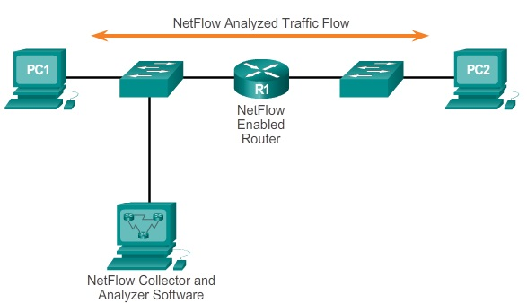
NetFlow

Slide 32
NetFlow
NetFlow
  Measuring who is using what network resources for what purpose.
  Accounting and charging back according to the resource utilization level.
  Using the measured information to do more effective network planning so that resource allocation and deployment is well-aligned with customer requirements.
  Using the information to better structure and customize the set of available applications and services to meet user needs and customer service requirements.

Slide 33
NetFlow
NetFlow uses a push-based model.
The collector simply listens for NetFlow traffic, and the networking devices are in charge of sending NetFlow data to the collector, based on changes in their flow cache.
NetFlow only gathers traffic statistics.
A flow is a unidirectional stream of packets between a specific source system and a specific destination.
  Source IP address, Destination IP address, Source port number, Destination port number
  Layer 3 protocol type, Type of Service (ToS) marking, Input logical interface

Slide 34
NetFlow
Configuring NetFlow
  Step 1. Configure NetFlow data capture
    Captures data from ingress (incoming) and egress (outgoing) packets.
    ip flow ingress
    ip flow egress
  Step 2. Configure NetFlow data export
    IP address or hostname of the NetFlow collector
    UDP port NetFlow collector listens. (99, 2055, 9996)
    Version (1, 5, 7, 8, 9)
    ip flow-export destination ip-address udp-port
    ip flow-export version version

Slide 35
NetFlow
  Step 3. Verify NetFlow, its operation and statistics
    The exported data can be analyzed on a workstation running an application, such as SolarWinds NetFlow Traffic Analyzer, Plixer Scrutinizer, or Cisco NetFlow Collector (NFC).

Slide 36
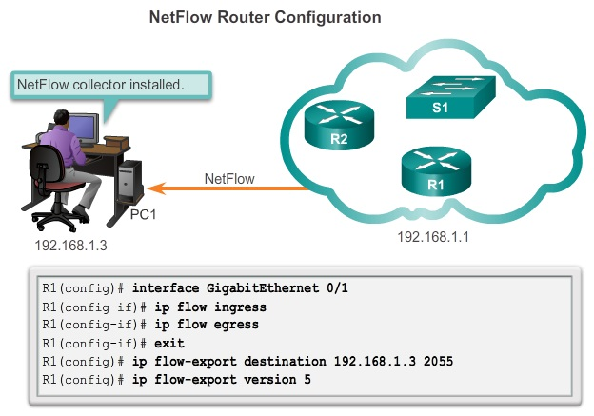
NetFlow

Slide 37
NetFlow
To display a summary of the NetFlow accounting statistics, as well as which protocol uses the highest volume of the traffic, and to see between which hosts this traffic flows, use the show ip cache flow.
show ip flow interface
show ip flow export

Slide 38
NetFlow
A NetFlow collector is a host that is running application software. This software is specialized for handling raw NetFlow data.
NetFlow collectors aggregate and organize NetFlow data as prescribed by the network administrator within the constraints of the software.
The NetFlow data is written to a drive, at specified intervals.
A NetFlow collector provides real-time visualization and analysis of recorded and aggregated flow data.

Slide 39
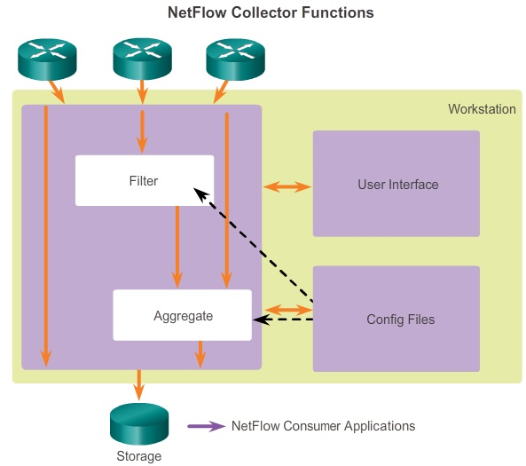
NetFlow

Slide 40
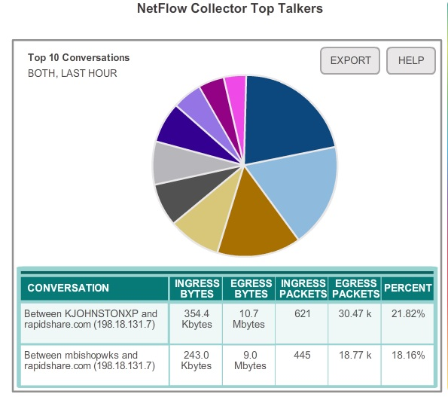
NetFlow

